Slide 1

ITS 2.0 Enriched Terminology Annotation Showcase
Presentation & User Guide
http://taws.tilde.com/
Tilde, May 17, 2013

Slide 2
Brief Introduction
The showcase allows users to automatically annotate terminology in ITS 2.0 enriched content in HTML5, XLIFF and plaintext formats.
The users of the showcase can be:
human users, e.g., translators, terminologists, etc.
machine users, e.g., machine translation systems, terminology management systems, computer aided translation systems, etc.
ITS 2.0 content analysis and terminology annotation for the showcase are performed by a dedicated Terminology Annotation Web Service API that provides a Web-based interface for the TaaS Terminology Services that perform:
term candidate annotation using state-of-the-art statistical methods
term bank based term annotation using terminology resources from EuroTermBank.

Slide 3
Architecture
Supported formats: Plaintext, HTML5 + ITS 2.0, and XLIFF 1.2 + ITS 2.0
Showcase languages: English, Latvian, Lithuanian

Slide 4
ITS 2.0 Metadata Integration
TAWS API
Segment Content
Extract Segments
Elements Within Text
Analyse ITS Content
Locale Filter
Language Information
Domain
Tag Term Candidates
ITS
Content I18N
TaaS API
Terminology
HTML5
or XLIFF
Find Term References
HTML5
or XLIFF
Return Content
Apply Terminology Mark-up
TAWS API

Slide 5
ITS 2.0 Data Categories Supported (1/2)
The ITS 2.0 Enriched Terminology Annotation Showcase consumes the following data categories (in global and local manner):
Domain – the content is split and analysed per domain separately in order to allow:
term filtering in term bank based terminology annotation
domain-specific term ranking in statistical terminology annotation
Elements Within Text - to decide which elements are extracted as in-line codes and sub-flows
Language Information – the content is split and analysed per language separately
Locale Filter - only the text in the locale as specified by the user defined language is analysed
Terminology - the mark-up of existing terminology metadata is preserved

Slide 6
ITS 2.0 Data Categories Supported (2/2)
The ITS 2.0 Enriched Terminology Annotation Showcase produces local annotation of Terminology:
The HTML <span> elements with the its-term="yes", its-term-confidence, and its-term-info-ref attributes in HTML5
The <mrk> elements with the mtype="term", itsx:termConfidence, and itsx:termInfoRef attributes in XLIFF
The annotation service is identified in the content with:
its-annotators-ref="terminology|http://tilde.com/term-annotation-service" attribute in HTML5
its:annotatorsRef="terminology|http://tilde.com/term-annotation-service" attribute in XLIFF

Slide 7
Plaintext Input Example

Slide 8
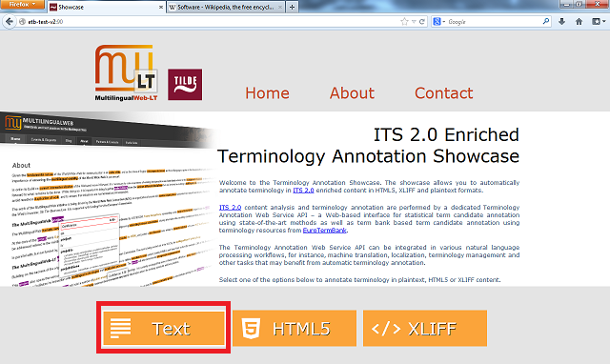
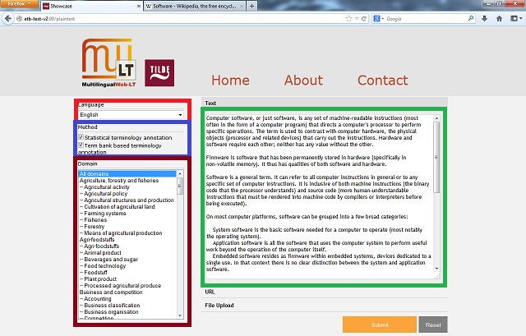
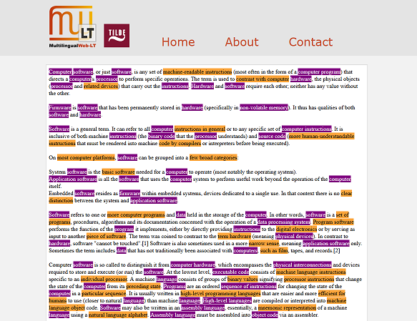
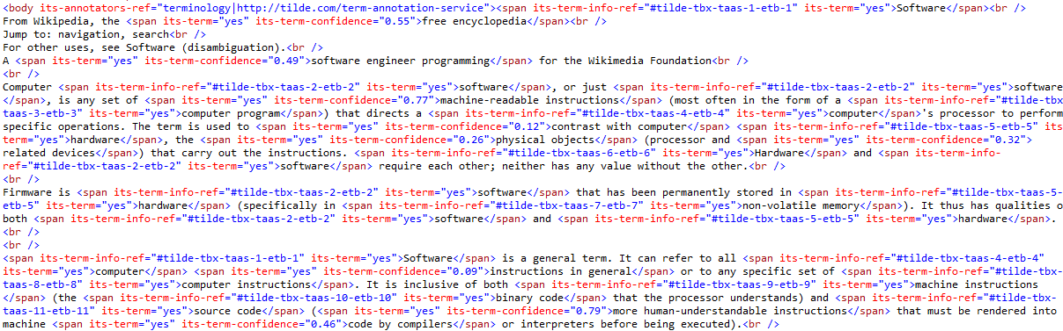

Showcase Web Page: Plaintext term annotation (1/3)
Select «Text»
Select the language, the term annotation method(s), and the domain if the term bank based term annotation method is selected
Enter the text for term annotation (optionally enter a URL or upload a document)
Select «Submit»
Terms are visualised in the Showcase Web page
The annotated content can be downloaded in HTML5 format by selecting «Download»
The content is sent to the TaaS platform’s Terminology Services for terminology annotation
The plaintext is transformed to HTML5 (to add ITS 2.0 metadata)
ITS 2.0 Terminology metadata is added to the HTML5 content

Slide 9

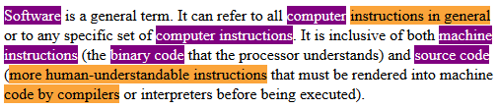
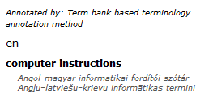
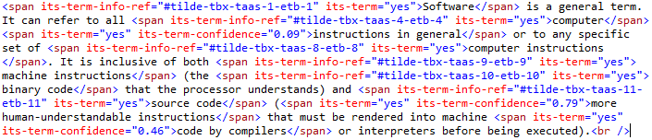
Showcase Web Page: Plaintext term annotation (2/3)
Term candidates annotated with the statistical terminology annotation method are annotated also with a term confidence
Hovering the cursor over the annotation triggers a tooltip window
Terms annotated with the term bank based terminology annotation method are linked to a term entry stored within the HTML5 document

Slide 10
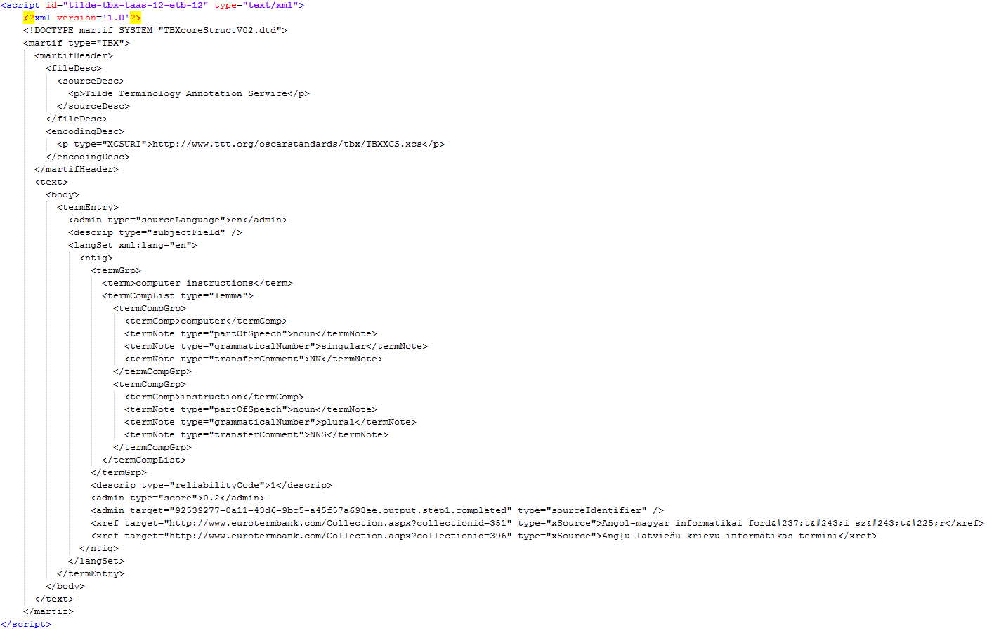
Showcase Web Page: Plaintext term annotation (3/3)
Term entries for terms identified in EuroTermBank are stored in TBX format in a <script> element that is placed in the HTML5 document.

Slide 11
HTML5 Input Example

Slide 12
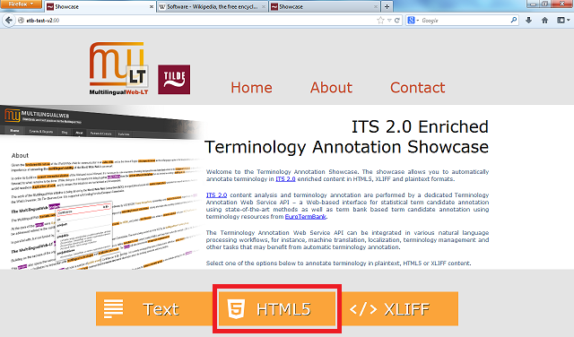
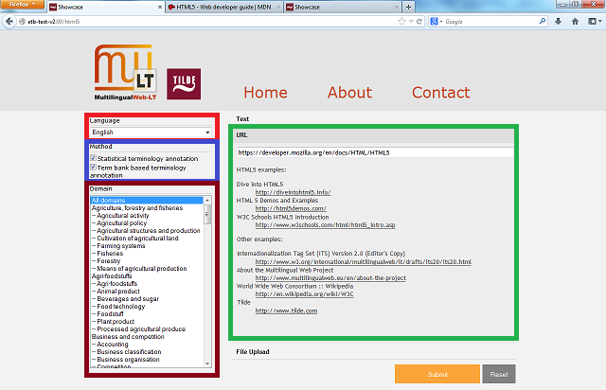
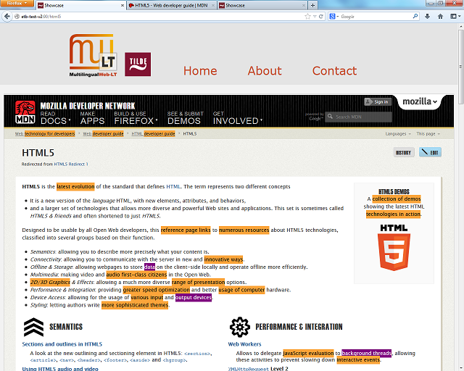
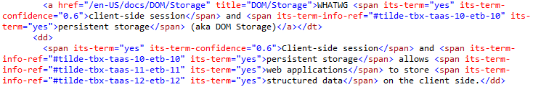
Select «HTML5»
Select the language, the term annotation method(s), and the domain if the term bank based term annotation method is selected
Enter the URL for term annotation (optionally enter HMTL content as text or upload a document)
Select «Submit»
Terms are visualised in the Showcase Web page
The annotated HTML5 content can be downloaded by selecting the «Download» button
Showcase Web Page: HTML5 + ITS 2.0 term annotation (1/3)
HTML5 content is divided in different domain and language dimensions
The content is separately sent to the TaaS platform’s Terminology Services for terminology annotation
ITS 2.0 Terminology metadata is added to the HTML5 content

Slide 13




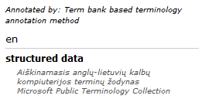
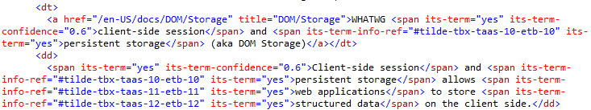
Showcase Web Page: HTML5 + ITS 2.0 term annotation (2/3)
Hovering the cursor over the annotation triggers a tooltip window
Term candidates annotated with the statistical terminology annotation method are annotated also with a term confidence
Terms annotated with the term bank based terminology annotation method are linked to a term entry stored within the HTML5 document

Slide 14
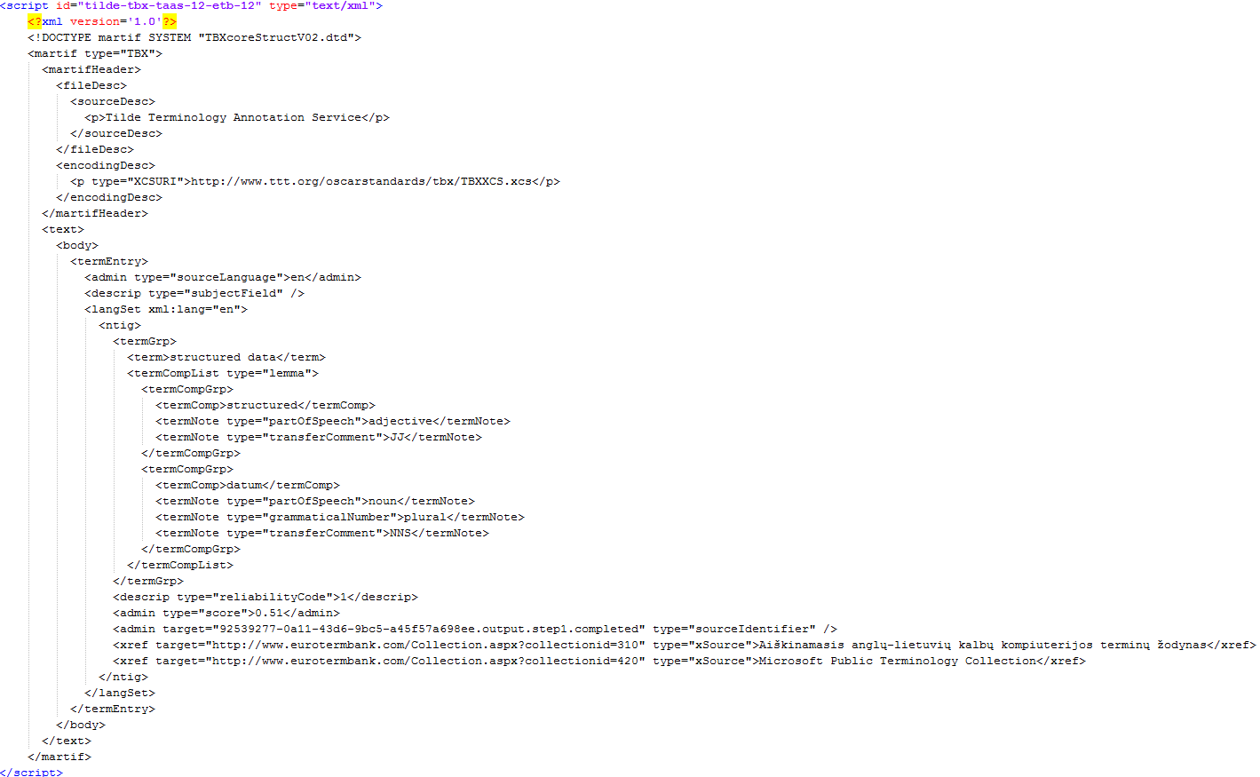
Showcase Web Page: HTML5 + ITS 2.0 term annotation (3/3)
Term entries for terms identified in EuroTermBank are stored in TBX format in a <script> element that is placed in the HTML5 document.

Slide 15
XLIFF Input Example

Slide 16
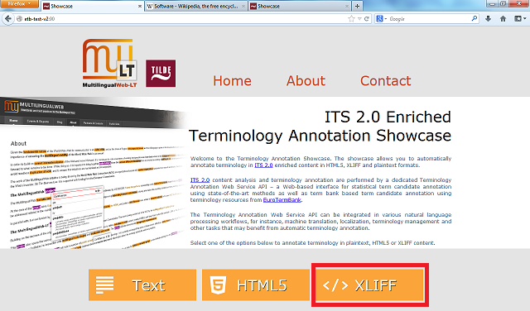
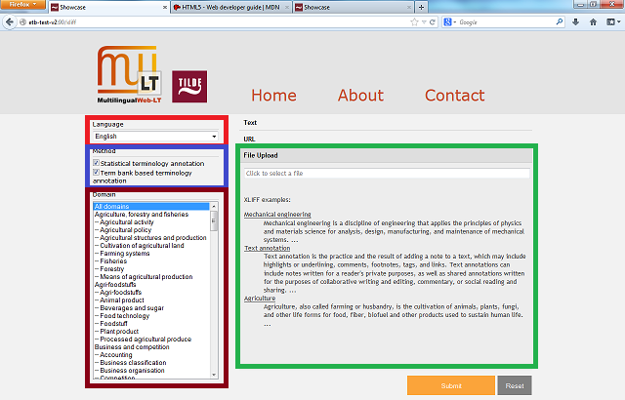
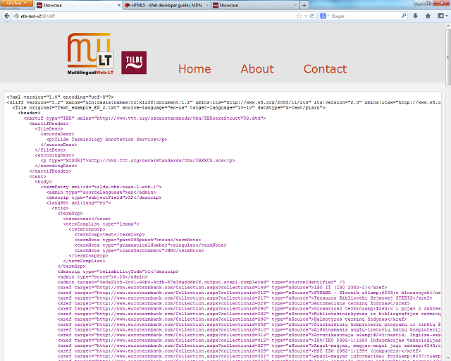
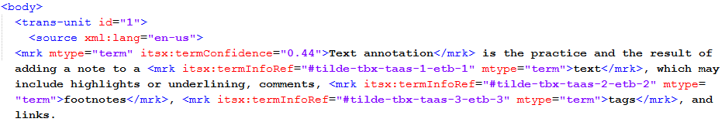
Select «XLIFF»
Select the language, the term annotation method(s), and the domain if the term bank based term annotation method is selected
Upload the XLIFF file for term annotation (optionally enter XLIFF content as text or enter a URL)
Select «Submit»
Terms are visualised in the Showcase Web page
The annotated XLIFF content can be downloaded by selecting the «Download» button
Showcase Web Page: XLIFF + ITS 2.0 term annotation (1/2)
XLIFF content is divided in different file, domain, and language dimensions
The content is separately sent to the TaaS platform’s Terminology Services for terminology annotation
ITS 2.0 Terminology metadata is added to the XLIFF content

Slide 17
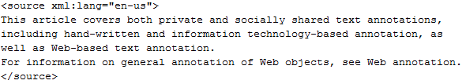
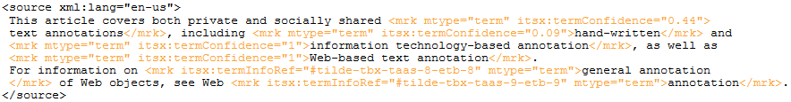
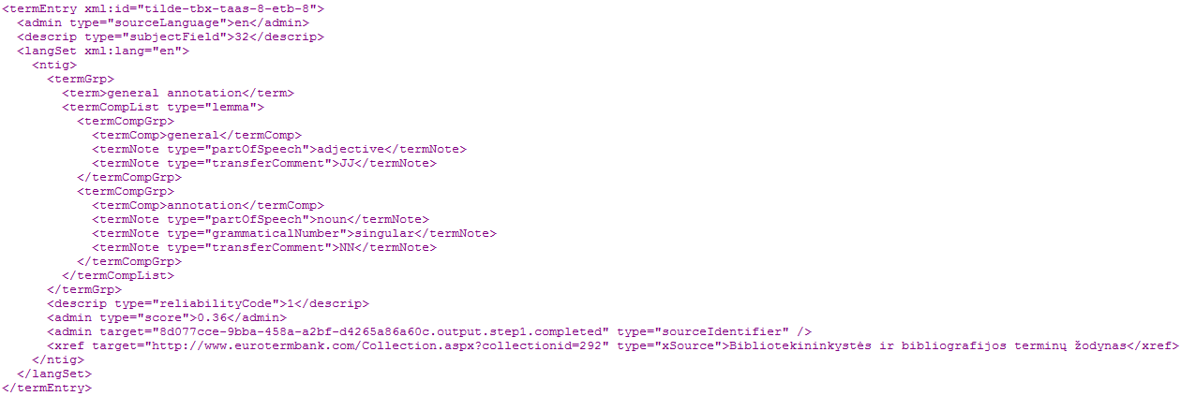
An excerpt of an XLIFF document
XLIFF content is visualised by marking the produced annotation
ITS 2.0 metadata are marked in orange (see above)
term entries in TBX format are marked in purple (an excerpt is given to the left)
Showcase Web Page: XLIFF + ITS 2.0 term annotation (2/2)

Slide 18
☺ Thank You!
The Showcase Web Page can be accessed at: http://taws.tilde.com
The team behind the ITS 2.0 Enriched Terminology Annotation Showcase
Tatiana Gornostay - terminology services manager
Andis Lagzdiņš – senior developer
Pēteris Ņikiforovs – junior developer
Mārcis Pinnis – researcher
Lāsma Saulīte – graphics designer
Artūrs Vasiļevskis – project manager
For more information on Terminology Services provided by Tilde please contact:
Tatiana Gornostay
tatiana.gornostay@tilde.lv
Tilde, Vienibas gatve 75a, Riga, Latvia

